Slide 1
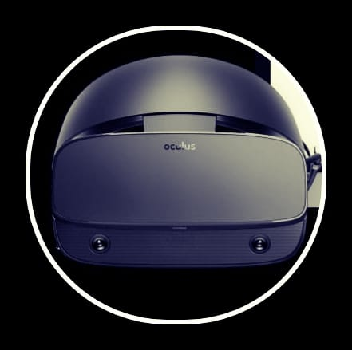
Education development
Project ID
Name | Education development
Description | A Program that uses virtual reality glasses to facilitate the educational process
Sponsor | Ministry of communications and information technology
Project Team Resources | Hardware : 20 laptop - 5 servers

Slide 2
THE MAIN GOAL OF THIS PROJECT is ….
Medical education is changing. Simulation is increasingly becoming a cornerstone of clinical training and, though effective, is resource intensive. With increasing pressures on budgets and standardization, virtual reality (VR) is emerging as a new method of delivering simulation. VR offers benefits for learners and educators, delivering cost-effective, repeatable, standardized clinical training on demand. A large body of evidence supports VR simulation in all industries, including healthcare. Though VR is not a panacea, it is a powerful educational tool for defined learning objectives and implementation is growing worldwide. The future of VR lies in its ongoing integration into curricula and with technological developments that allow shared simulated clinical experiences. This will facilitate quality interprofessional education at scale, independent of geography, and transform how we deliver education to the clinicians of the future.

Slide 3
THE MAIN GOAL OF THIS PROJECT is ….
When activating the session:- A full learner management system gives educators total control of training delivery, providing clinical experiences on demand to integrate seamlessly with curriculum requirements. Running advanced simulation systems, (App’s name) lets learners practice just like in real life. Fully-immersive scenarios, artificial intelligence-driven patient behavior, adaptive communication, dynamic physiology and unique unwellness systems combine to deliver clinical experiences that feel real.Learners receive immediate, comprehensive feedback on technical and non-technical performance - including communication, teamwork and prioritization - without the need for faculty. All learning is customizable to ensure institutions meet specific requirements. Detailed metrics and intuitive dashboards allow learners to monitor and optimize performance. Educators and managers can easily view all aspects of engagement and performance, identifying training needs and ensuring all learners reach the top of their license efficiently and effectively. To the end and feedback from the behaviours of learners .

Slide 4
Project scope:
1- The purpose of the application is to facilitate the educational process using virtual reality glasses.
2- The project will be completed and the application tested for a period of 8 week at the level of Assiut University (faculty of medicine ), and it will cost (300000 $).
3- The role of the developers comes in the first stage in creating some applications for the faculties of universities and their stages, and using these applications and running them on glasses. We will need to collect sufficient data on all the faculties so that the necessary procedures are facilitated.
4- The application is made using the Java language, communicating with the glasses and conducting an experiment on the application, and later the network team begins to activate the application in all university faculties devices.
5- The system will be reviewed and monitored, as well as maintenance and repair of glasses in the event of any problem, for a period of one month from the start of use.

Slide 5
ID | Description | Predecessor | Time (Weeks)
A | Flutter | None | 2
B | Backend | A | 3
C | Frontend | B | 1
D | Hardware | A | 2
E | Server | D | 2
F | Wires and Switches | C,E | 2

Slide 6
1 | B | 4
0 | Backend
1 | 3 | 4
4 | C | 6
0 | Frontend
4 | 2 | 6
0 | A | 1
0 | Flutter
0 | 1 | 1
6 | F | 8
0 | Wires and Switches
6 | 2 | 8
1 | D | 3
0 | Hardware
1 | 2 | 3
3 | E | 5
0 | Server
3 | 2 | 5

Slide 7
WBS
Start
End
Hardware& Sofware
Execution
1
3
4
1.1
Requirments
1.2
Doing Study about the glasses
&collect necessary data
1.3
Plan the Project and Application
2
3
Dividing Tasks
3.2
Working on creating the app
3.3
Test Functions
3.4_
Interface the Application
4.1
Test the Application
4.2
Explan and Fixed Errors
4.3
Finish the Application
4.4
Install and activate the application
2.1
Bring the equipment
2.2
Operating System of Glasses
2.3
Testing Glasses

Slide 8
ED APP
1-team - 2flutter -2web developer | Time 2weeks | Budget 50000$
2-backend developer | Time 3week | Budget 20000$
3-frontend developer | Time 1week | Budget 20000$
4-Security | 10000$
Hardware 20 laptop | Budget 40000$ | Time 2weeks
5 Server | Budget 100000$ | Time 2weeks
Wires and switches | Budget 20000$ | Time 2week
Total budget : 300,000$ total time: 8 weeks
Glasses Budget 40000$

Slide 9
Gantt Chart
ED | Q1 2021 |  | Q2 2021 |  | Q3 2021 |  | Q4 2021
 | 3 Nov | 10 Nov | 17 Nov | 24 Nov | 1 Dec | 8 Dec | 15 Dec | 22 Dec
Planning
Research
Design
Implementation
Follow up

Slide 10
RISKS
Severity | Description
Low | Students do not accept changing their learning style
Low | Slow to understand new technologies
Medium | Some colleges refused to apply these techniques
High | Increase in the cost
High | Approval from the Ministry of communications and information technology
High | Weak university infrastructure
High | Exorbitant cost

Slide 11
SOLUTIONS
Severity | Description
Low | The first year without fail, but there will be an evaluation
Low | Provides videos explaining how to deal with new technology
Medium | We clarify the idea of the project and the many positive aspects that benefit the faculty and students
High | We will make VR glasses in Egypt to reduce the cost
High | We will explain to the Ministry a schedule with specific goals to advance education
High | We will provide everything the project needs from the Internet

Slide 12
THE MEETING TIMES :
Every Sunday an online meeting.
Every Wednesday a meeting in the college.

Slide 13
Team members :
1- Moataz Ahmed Refaat abd ulbasset
2- Mostafa Mahmoud Ragab Hassan
3- Mostafa Hamouda Mohamed Ramadan
4- Moustafa Morad Ahmed Mohammed
5- Mahmoud Wael Sayed Ahmed

